Slide 1
HEALTHWATCH AND PUBLIC INVOLVEMENT ASSOCIATION
Thursday, November 28th, 2013
Malcolm Alexander
HAPIA

Slide 2
Malcolm Alexander – was Chair of NALM –
National Association of LINks Members,
Board Member, Hackney Healthwatch
Vice Chair, ‘Action against Medical Accidents’
Chair, ‘Patients Forum for the London Ambulance Service’
Was member of the ‘DH Healthwatch Programme Board’
Former Lecturer in ‘Patient and Public Involvement in Health and Social Care.’

Slide 3
TODAY’S OBJECTIVES
PROMOTING AND RELEASING THE POWER OF COMMUNITIES TO INFLUENCE THE NHS AND SOCIAL CARE
BUILDING LOCAL HEALTHWATCH INTO ORGANISATIONS THAT HOLD THE SECTOR TO ACCOUNT
IDEAS AND CHALLENGES TO THE PUBLIC INVOLVEMENT SYSTEM
LOBBYING TO CREATE A STRONGER MORE EFFECTIVE LOCAL SYSTEM OF MONITORING AND INFLUENCE

Slide 4
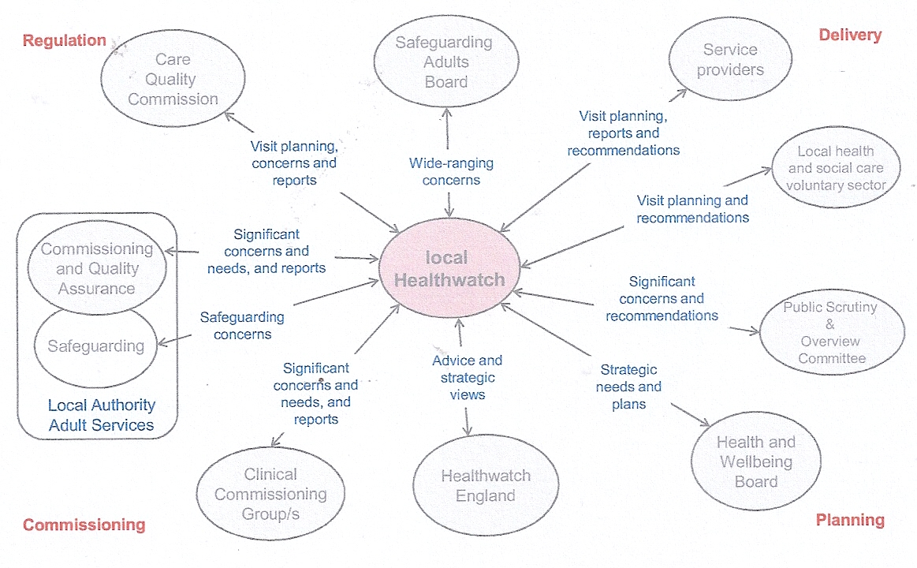
THE ROLE OF HEALTHWATCH

Slide 5
PROMOTING AND RELEASING THE POWER OF COMMUNITIES TO INFLUENCE THE NHS AND SOCIAL CARE
Ending the cycle of building and destroying public involvement organisations – CHC, Patients’ Forum, LINks and now Healthwatch
Enabling the Healthwatch to be owned by local people
Empowering users and carers to have real clout to improve services
Elections to Healthwatch England

Slide 6
BUILDING LOCAL HEALTHWATCH INTO ORGANISATIONS THAT HOLD THE SECTOR TO ACCOUNT
Representative members from local communities, e.g. Elections from user groups and vol sector
Effective monitoring systems for all local health and social care services
Enhanced powers for LHW to formally object to Health and Wellbeing Boards and CCGs when they believe services are unsafe, inadequate or poor quality

Slide 7
IDEAS AND CHALLENGES TO THE PUBLIC INVOLVEMENT SYSTEM
One stop shops for Local Healthwatch – move them to the high road where the public can see them – centres for monitoring care, receiving intelligence from the public, handling complaints and advising the public about what to do next in a crisis.
Widespread publicity about the role of local Healthwatch and how to access its services
Accountability mechanism requiring CCGs and local authorities to public respond to local Healthwatch recommendations on services quality, access to services and safety.

Slide 8
LOBBYING TO CREATE A STRONGER MORE EFFECTIVE LOCAL SYSTEMS OF MONITORING AND INFLUENCE
Local Healthwatch should be independent of local authorities influence and funding
Influence over commissioning priorities of CCGs/local authorities
Right of access to all CCG and local authority commissioning documents and influence throughout commissioning cycle
Access to comprehensive data about all complaints, serious incidents, and actions to reduce harm and improve care

Slide 9
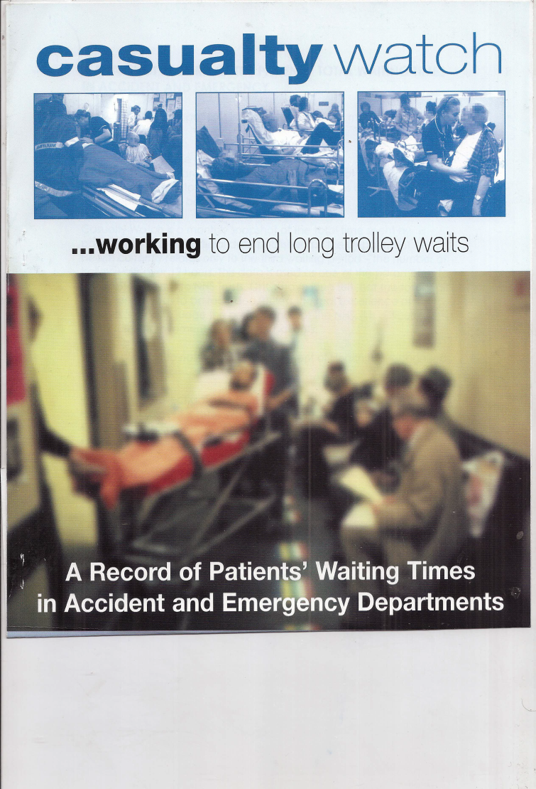
CASUALTY WATCH

Slide 10
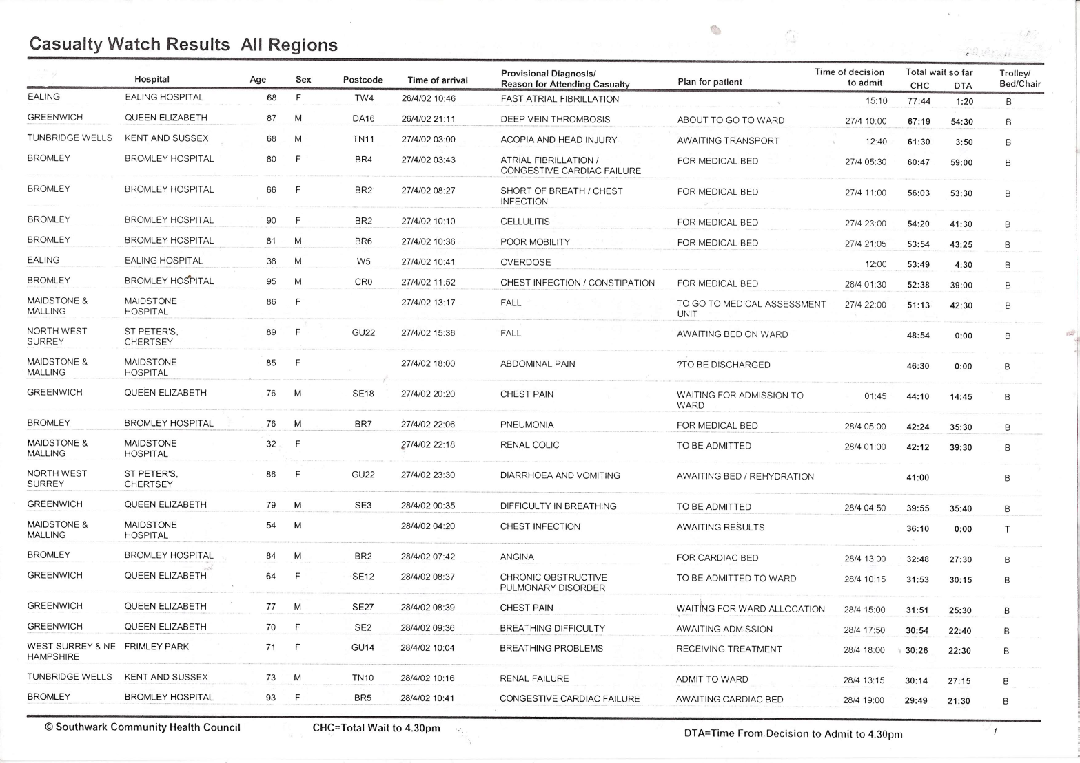
WHAT IS GOING ON?

Slide 11
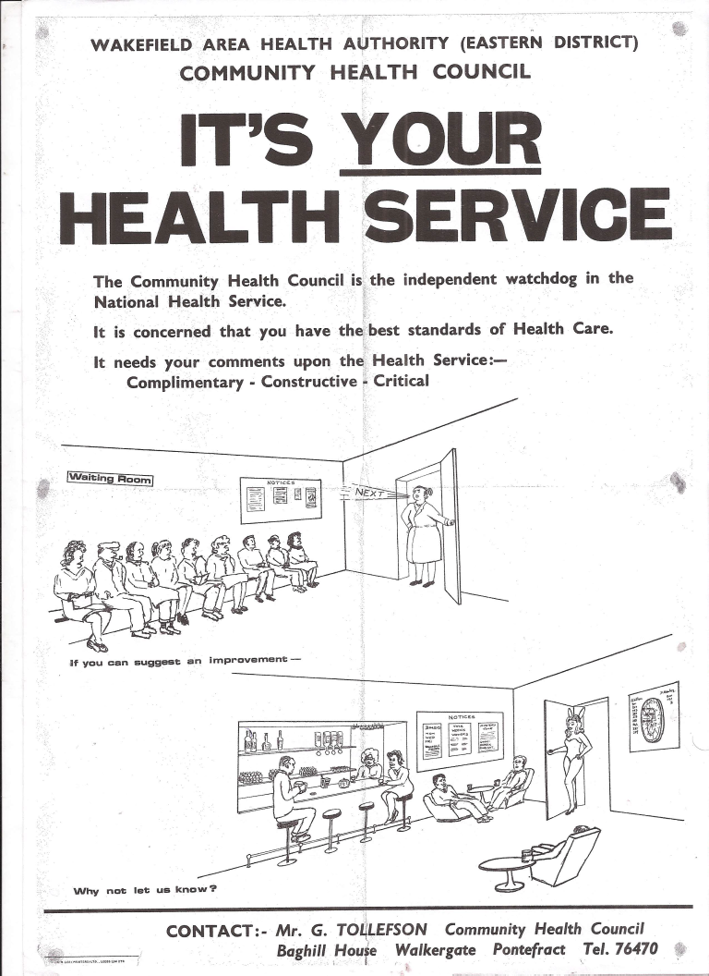
IT’S YOUR HEALTH SERVICE

Slide 12
CONTACT
MALCOLM ALEXANDER
HAPIA2013@AOL.COM
WWW.NALM2010.ORG.UK

