Slide 1
CHALLENGING THE SYSTEM
LESSONS FROM THE CREATION OF PPI BODIES

Slide 2
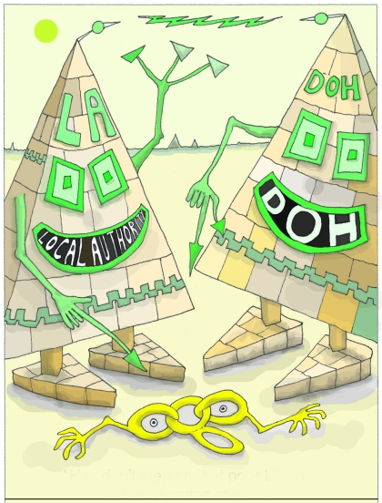

Slide 3
Challenge is that
there IS no system
- huge crushing architecture of NHS and LAs and government
-people working within it have to sign- up to the pretence
REALITY = changing/dislocated/kaleidoscopic

Slide 4
Shifting sands
Peeling layers
Changing labels[ PPI Fs, LINks, LHW]
Rotating post-holders
Realigning organisations
Changing national/regional leads
Changing policies
Changing ministers

Slide 5
No stable relationships
No enduring policies
No continuity of ownership
= no authentic ppi, only US

Slide 6
Manipulation
Exploitation
Therapy
Informing

Slide 7
NHS buzzwords – ‘transparency, accountability’
and
“Organisation with a memory”
The only authentic “memory”?
US, the public!

Slide 8
The so-called ‘system’ is
-London–centric
-short term [next job, next contract, next appointment, next government]
-highly pressurised
-inward looking

Slide 9
Result
-lacks in depth knowledge of other bits of provision
-lack of knowledge about how the overarching things work
-lacks knowledge of why things are as they are

Slide 10
Result = low level/short term initiatives
A] Manipulation/Exploitation eg- do our surveys/distribute our leaflets
B] Therapy eg– little meetings/ discuss 3 questions/flip charts. The ‘Diddums Manual’
C] Informing eg– talking at us/patronising us

Slide 11
Misinformation
No checks and balances
No oversight/policing

Slide 12
PATIENT/PUBLIC CONTROL?
IT CAN BE DONE
Tertiary trust 9000 staff
Lead for 3 docs + 3 managers + 6 patients
Intranet access + trust e-mail address + Athens password + library access + stationery + use of dept. secretary + catering code + room bookings code + DATIX input + equipment suppliers + training establishments + estates/planning/dept redesign + facilities review.

Slide 13
Very rare but hugely beneficial to:
-the system
-the professionals
-quality
-reputation
-etc

Slide 14
