Slide 1
The Power of the Healthwatch Network Dr Katherine Rake, Chief Executive of Healthwatch England
Notes:
Over the last year hardly a day has gone by without some health or social care scandal being splashed across the papers
Francis, Berwick, Keogh and most recently Clwyd Hart have all identified problems with engaging users of health and social care as being at the heart of the problem
We have already heard this morning from ADASS about the importance of complaints and feedback systems as a driver for improving quality
And from the LGO and the PHSO about some of the good work that is going on around complaint handling
But I would like to take the time to talk to you about ‘customer’ relations from the point of view of the patients, care users and their families
Or in other words … the consumers

Slide 2
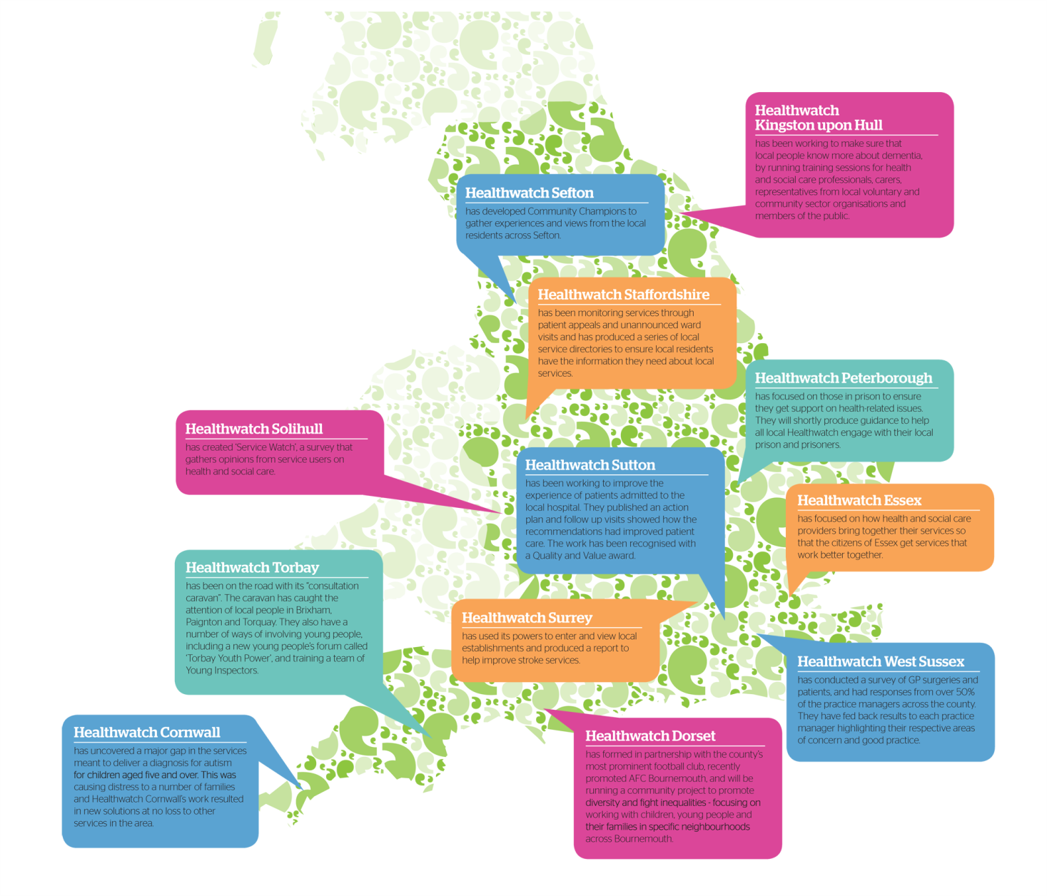
Local Healthwatch in action
Notes:
And what a difference local Healthwatch are already starting to make:
In Torbay the team have been out on the road in their ‘consultation caravan’ getting feedback from local residents about their experiences of health and social care
In Peterborough the local Healthwatch have been working with people in prisons to ensure they are getting the support they need on health related issues
Surrey local Healthwatch has been using it’s enter and view powers to assess local stroke services and have already submitted a report back to the local trusts which is helping to plug some of the gaps between hospital treatment and community care services

Slide 3
Reforming the complaints system
Complaints system is complicated and leaves people feeling lost and frustrated.
But if we can get it right:
Patients, care users and their families feel that their opinions matter
We can use the data from complaints to ensure same mistakes don’t happen again at a local level
We can use trends identified in complaints data to influence national policy
We plan to launch a national campaign to reform the complaints system – but we need your help
Together we are stronger than the sum of our parts
Notes:
Complaints are not ‘soft’ intelligence.
Listening to and acting on feedback from those let down by the system is the hardest form of evidence available for assessing what is going wrong.
If we can get it right:
Patients, care users and their families feel that their opinions matter
Use the data from complaints to ensure same mistakes don’t happen again at a local level
Use trends identified in complaints data to influence national policy

